Slide 1
Covid-19: Preparing for the Pandemic's Impact on Workers
Mental Health Issues in the World of Covid-19:
SUPPORTING EMPLOYERS AND EMPLOYEES

Slide 2
What Do We Know?
93% of employees believe that companies that survive COVID-19 will be those who support their employees’ mental health
COVID-19 four radical changes in US worker mental health needs. Ginger, April 2020
65% of Americans perceive that the economic consequences will have a larger impact on them than the Covid-19 virus
Harris Poll, Wave 7, online, April 11-13, 2020 (n=2013)

Slide 3
What are We Seeing
Adverse impact on the individual/employee’s mental health
Social isolation
The Unlonely Project
Health-related anxiety
General uncertainty of the future leading to increased anxiety
Depression
Substance abuse
Domestic abuse
National Sexual Assault Hotline
800-656-HOPE (4673)
National Domestic Violence Hotline
800-799-7233
Work (in)security
Financial concerns
HCWs and First Responders
Loss, grief, stress, PTSD and burn-out

Slide 4
Supporting Employees and Employers
Potential scenarios and questions:
Are support options different while working remotely (virtual) versus at the physical work location?
Will there be a surge in mental health concerns coinciding with physical workplace re-engagement?
What online support options are available?
What options are available to expand access to mental health support in the workplace?

Slide 5
How to Support Employees and Employers
Consider
Training focusing on coping mechanism strategies
Providing consistent, timely and accurate health information regarding Covid-19
Identifying activities that can serve as stress and anxiety relievers
Develop interactions that maintain engagement and collaboration
Educating team members on mental health-related services

Slide 6
Creating a Psychologically Safe Environment
What resources were provided BEFORE the pandemic?
How transferable are those resources to a virtual environment?
How feasible is it to expand what you were already doing?
Especially as employees begin to return to the physical environment?
Increase touch-points with employees
One-on-one engagements with manager-employee
Increased meeting frequency for the team
KEEPING EVERYONE ENGAGED!

Slide 7
Creating a Psychologically Safe Workplace
Where employees feel supported, empowered and engaged
National Alliance on Mental Health (NAMI.org)
Decreasing mental health stigma
Findyourwords.org
Mental Health America (www.mhanational.org)

Slide 8
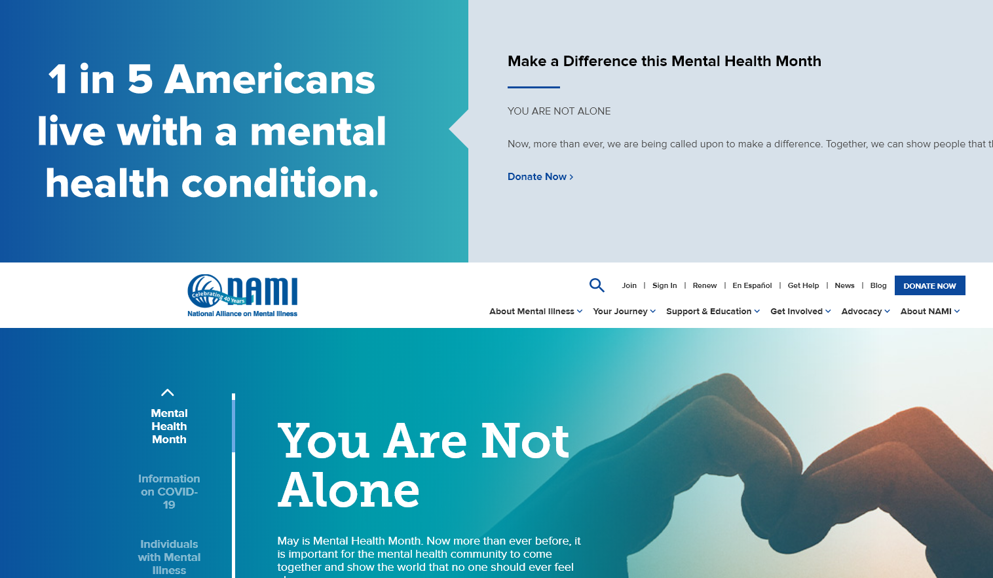
National Alliance on Mental Health (NAMI.org)

Slide 9
Findyourwords.org

Slide 10
Mental Health America https://www.mhanational.org

Slide 11
Things to Consider
Support and provide additional training to your managers
Identify/expand your resources (refer to full PP deck)
Are team members getting “Zoom” fatigue?
Greatest engagement benefit may occur through the formation of smaller team member cohorts and “buddy” systems
Is empathy and the importance of self-care for all employees consistently communicated and demonstrated at all levels of the organization? If not, why not?
Peer support can be a very effective tool in creating community and minimizing the “going it alone” mentality

Slide 12
Things to Consider
Employee Assistance Program (EAP) (expansion/enhancement)
Resiliency Training
Educate and update employees on how to access mental health care
mystrength.com
Support/expand your existing overall workforce health strategy (nutrition, exercise, smoking cessation, etc.)
Engagement opportunities
Virtual and/or
Small group support groups consistent with social distancing mandates
Develop “buddy” system

Slide 13
Mystrength.com

Slide 14
Resiliency
Mindfulness/meditation practices
In-person, when safe
App-based
Journaling
Gratitude
Volunteer work

Slide 15
Greater Good Science Center https://greatergood.berkeley.edu

Slide 16
Greater Good Science Center-University of California, Berkeley
The Greater Good Science Center studies the psychology, sociology, and neuroscience of well-being and teaches skills that foster a thriving, resilient, and compassionate society.

Slide 17
Meaning and Engagement with Work
Engagement
Creating community during social isolation
Art and Healing-The Unlonely Project
https://artandhealing.org

Slide 18
Social Drivers of Health
Social drivers/determinants of health relate to the situations in which people
Live
Work
Socialize
Social drivers account for up to 40% of health outcomes which can adversely effect
Health of the employee
Productivity of the employer
Institute for Clinical Systems Improvement. Going Beyond Clinical Walls Solving Complex Problems, October 2014.

Slide 19
Social Drivers of Health-Breakdown
Socioeconomic Factors: 40%
Education
Job stress
Family/social support
Income
Safety in the community
Physical Environment: 10%
Health Behaviors: 30%
Alcohol use
Sexual activity
Tobacco use
Diet
Exercise
Access to Health Care: 20%

Slide 20
Social Drivers of Health in the World of Covid-19
Address and support the social and economic needs of your employees
Pay particular attention to those employees who are
Furloughed
Working decreased hours
Identify resources for employees who are terminated
EAP/Financial Services-Benefit review/COBRA
Think more expansively
Identify ways to support the communities in which you work
Identify ways to support the communities where your employees live
Critical in communities that have been impacted greatest by Covid-19 due to health disparities and economic impact
Findhelp.org
Helpwhenyouneedit.org

Slide 21
Additional Resources
Employer Resources-Workforce Health
BSR.org (Business for Social Responsibility)
American Psychiatric Association
http://workplacementalhealth.org/Employer-Resources/The-Working-Well-Toolkit
Employee Resources
Findhelp.org
211.org
Helpwhenyouneedit.org
CDC: Stress and coping with Covid-19
https://www.cdc.gov/coronavirus/2019-ncov/daily-life-coping/stress-coping/index.html
American Psychological Association,-Covid 19 information and resources
https://www.apa.org/topics/covid-19
American Foundation for Suicide Prevention
AFSP.org

Slide 22
Business for Social Responsibility (BSR)

Slide 23
Working Well Toolkit http://workplacementalhealth.org/Employer-Resources/The-Working-Well-Toolkit

Slide 24
Findhelp.org

Slide 25
Helpwhenyouneed it.org

Slide 26
211.org

Slide 27
CDC-Stress and Coping with COVID-19 https://www.cdc.gov/coronavirus/2019-ncov/daily-life-coping/stress-coping/index.html

Slide 28
American Psychological Association https://www.apa.org/topics/covid-19

Slide 29
American Foundation for Suicide Prevention afsp.org

