Slide 1
Video 3: Designing Your Presentation (HANDOUT: Slide design examples)

Slide 2
Principles of Slide Design

Slide 3
EXAMPLE: Too Much Text On Slide

Slide 4
EXAMPLE: Alignment - Before

Slide 5
EXAMPLE: Alignment - After

Slide 6
EXAMPLE 2: Alignment – Before After (Note right-sided alignment, plus color contrast)

Slide 7
ALIGNMENT: Flush Left vs. Flush Right

Slide 8
ALIGNMENT: Text with Objects

Slide 9
EXAMPLE: Proximity - Before

Slide 10
EXAMPLE: Proximity - After

Slide 11
EXAMPLE 2: Proximity - Before

Slide 12
EXAMPLE 2: Proximity - After

Slide 13
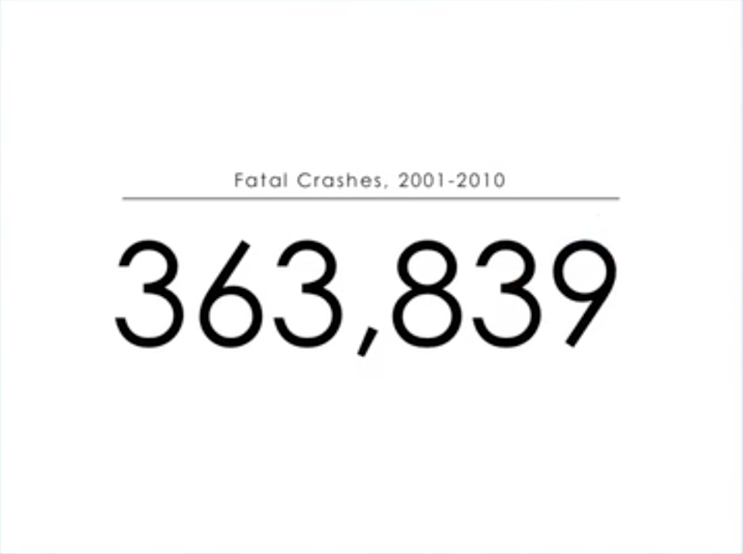
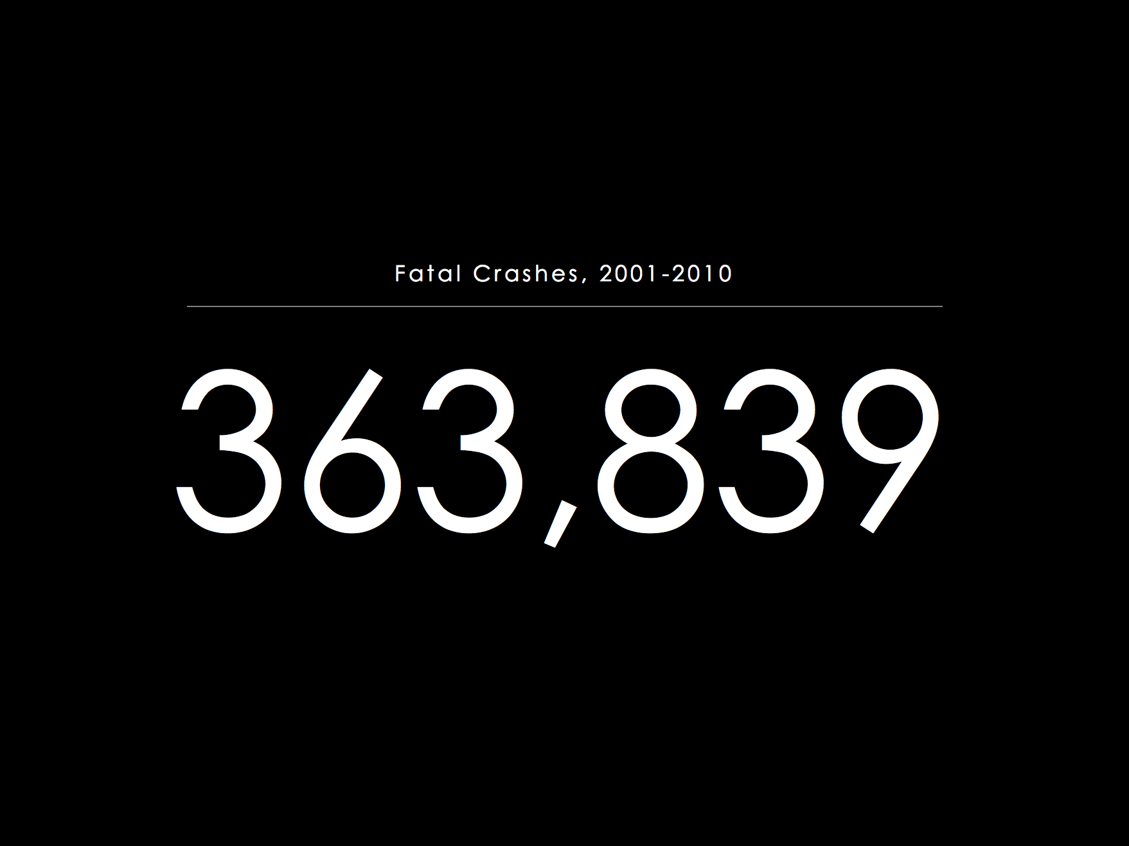
CONTRAST: Light vs. Dark Background

Slide 14
CONTRAST: Large vs. Small Font

Slide 15
TEXT SIZE: Shows Importance

Slide 16
Digital Interventions have a beneficial effect on CVD (Mayo Clinic)
REPETITION: Consider An Identifiable Title Bar Theme to unite your Slides

Slide 17
Digital Interventions have a beneficial effect on CVD (Mayo Clinic)

Slide 18
Digital Interventions have a beneficial effect on CVD (Mayo Clinic)
Pooled meta analysis of 51 research articles:
6.5% absolute risk reduction overall
Telemedicine, web-based solutions, and SMS texting best
Primary prevention benefit
CVD risk factors, weight loss, BMI, BP, total and LDL cholesterol
Reduction in Framingham risk scores
No observed benefit in CVD outcomes
Secondary CVD prevention and heart failure
7.5% absolute risk reduction in secondary prevention groups
Benefit on all-cause mortality and CVD morbidity
40% relative risk reduction in CVD outcomes
Mayo Clin proc 2015; 90(4): 469

Slide 19
Digital Interventions have a beneficial effect on CVD (Mayo Clinic)
Pooled meta analysis of 51 research articles:
6.5% absolute risk reduction overall
Telemedicine, web-based solutions, and SMS texting best
Primary prevention benefit
CVD risk factors, weight loss, BMI, BP, total and LDL cholesterol
Reduction in Framingham risk scores
No observed benefit in CVD outcomes
Secondary CVD prevention and heart failure
7.5% absolute risk reduction in secondary prevention groups
Benefit on all-cause mortality and CVD morbidity
40% relative risk reduction in CVD outcomes
Mayo Clin proc 2015; 90(4): 469

Slide 20
Make an INTERESTING Presentation Description (To get people to actually show up!)

Slide 21
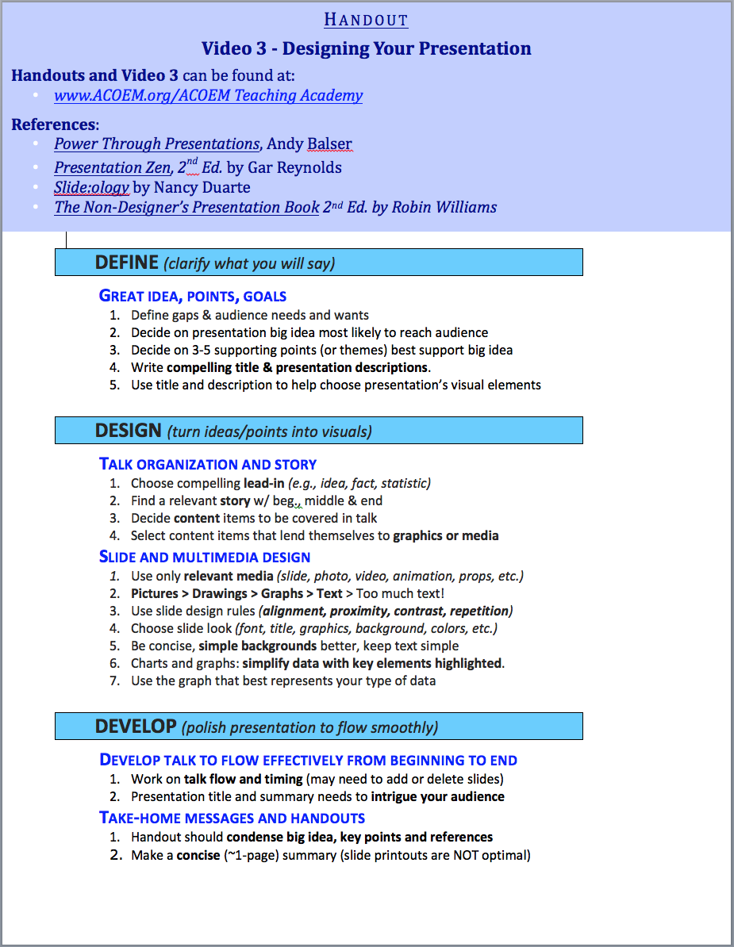
Make a 1-Page handout (So people remember what you said after your talk)

